Slide 1
Programming Fundamentals
by Abeeha Sattar

Slide 2




Input – Process – Output (IPO)
Input:
Lemons + Sugar + Water
Insert money + Press button
Dirty clothes + Detergent + Water
Food + Time input
Process:
Mix ingredients
Machine checks payment and drops item
Washing machine washes, rinses and spins the clothes
Heats food with microwaves
Output:
Glass of lemonade
Snack comes out
Clean clothes
Hot food

Slide 3
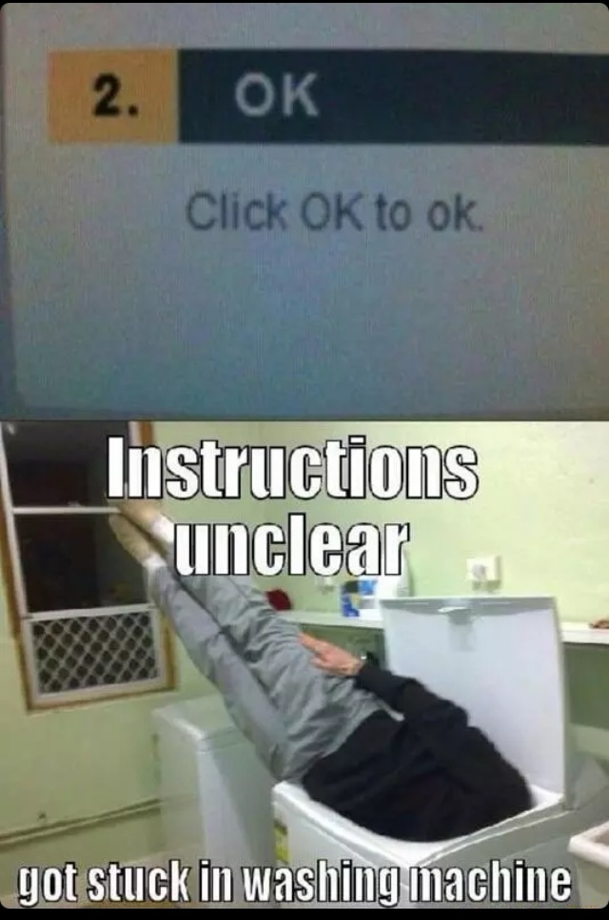
Algorithm
Think of it as a set of instructions that allow you to solve a problem.
Each algorithm you write will have:
Input(s)
Process detailing what to do
Output(s)
A computer is very good at following exact instructions.
But providing the right instructions is up to you!

Slide 4
Activity:
Write algorithms for the following:
Writing and sending an email to your friend.
Ordering some wings from KFC
Since we’re doing this online, write it in your notebooks.
Submissions online on GCR so that I can make sure you are doing it.
For submission, I need a picture of your work

Slide 5

Algorithm: Making Popcorn (not the microwave ones)
Get ingredients (corn kernels, oil, salt)
Get a pan
Turn on stove
Put pan on stove
Put oil in pan
Put corn kernels and salt when the oil is hot enough
Close the lid
Wait until the kernels stop popping
Turn stove off
Remove popcorn from the pan and serve it in a bowl.
They forgot to remove the lid…

Slide 6
Pseudocode
Pseudo = false/fake/ imitation
Pseudocode is an informal way of writing code.
It represents the algorithm of the program in natural language and mathematical notations.
So, how is it different from an algorithm?
Algorithms are usually written in natural language, meanwhile pseudocode follows some rules and syntax.
Algorithms explain what needs to be done, while pseudocode shows how the code might look when being converted into real code.

Slide 7
Keywords for writing Psuedocode
START: Marks the start of your pseudocode
INPUT: Used to get input from a user (via keyboard or other input devices)
READ/GET: Used when you are reading data from a file
PRINT/DISPLAY/SHOW: Displays the output on an output device (e.g. screen)
COMPUTE/CALCULATE/DETERMINE: Calculates the result of some expression
SET/INIT: Initializes values of variables
INCREMENT/BUMP: Increases the values of variables
DECREMENT: Decreases the values of variables
END: Marks the end of your pseudocode

Slide 8
Pseudocode for adding two numbers:
START
PRINT “Enter two numbers to be added”
INPUT num1
INPUT num2
CALCULATE sum = num1 + num2
PRINT sum
END

Slide 9
Activity:
Write pseudocodes for these:
Make a simple calculator which takes 2 input numbers and do basic arithmetic operations of mathematics such as addition, subtraction, division and multiplication.
A swapper which swaps the values of two user inputs
Convert temperature from Celsius to Fahrenheit
Hint: °F = (59​ × °C) + 32

Slide 10
Fin~

